Slide 1
DBMS PROJECT
GROUP 4 (Project 7):
G Kruthika: AM.EN.U4CSE19319
Nandita Menon: AM.EN.U4CSE19337
Satya Harthik S: AM.EN.U4CSE19352
Sruthi S: AM.EN.U4CSE19354

Slide 2
PROJECT ABSTRACT
ICTS department has the provision of five printers to print five different files at a time. The staff member can request for printing the required file. The files which have been printed, the details of the person who requested the print, date and time of print is to be maintained. Each print job is assigned to a clerical staff to verify if the printout request is valid, the staff who requested it is eligible, whether the request is official or personal, etc. based on which he/she takes the . One delivery person is responsible to deliver the printouts to respective staff member after checking the personal details such as name, room no of the staff member, phone no. The print details such as type of paper used (A3, A4, etc.), single page print or double side print, color print or not, etc. is also to be maintained. At a time, a file can be printed only on one printer. The cost of each print is to be maintained, to know the printing expense at the end of each month.

Slide 3
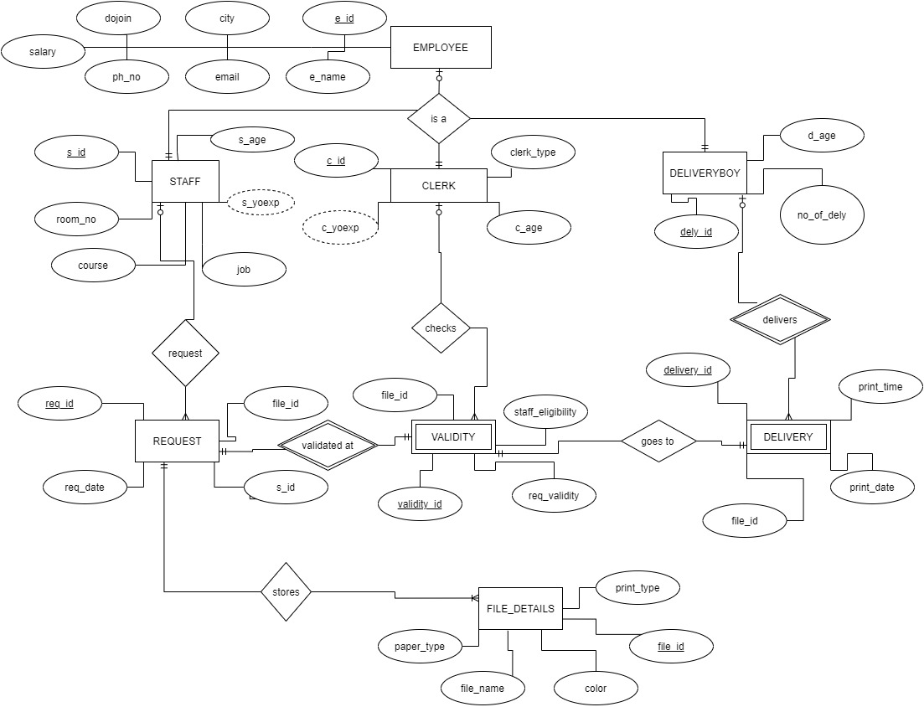
ER DIAGRAM

Slide 4
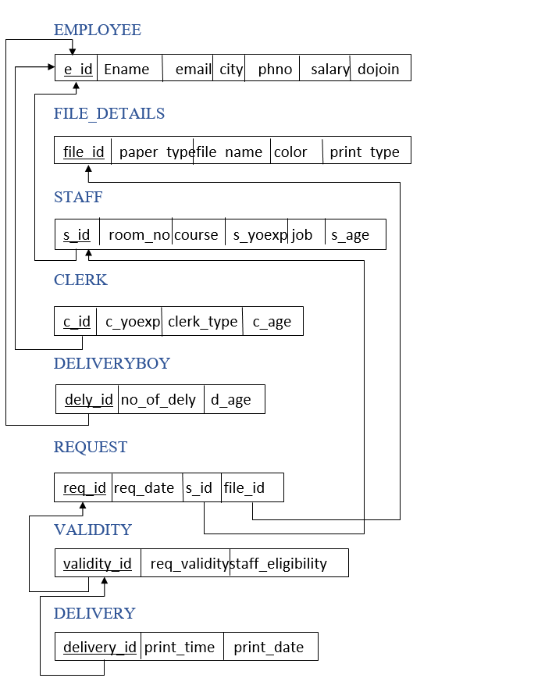
RELATIONAL SCHEMA DIAGRAM

Slide 5
USE CASE QUERIES
/* group by and having */
select count(s_id) from STAFF group by s_id having job='Professor’;
--use case: find the number staff who's working as a professor--
--end--
/* using order by */
select e_id,e_name,email,salary from EMPLOYEE order by salary desc;
--use case: to list the employee details in descending order by salary--
--end--
/* aggregation */
select count(req_id) from request where req_type='official’;
--use case: find the number of request given by staff who's request type is official—
-- end--
/*using join */
select req_id from request natural join validity where staff_eligibility='eligible’;
--use case: to display the request given by staff where staff is eligible--
-- end--

Slide 6
USE CASE QUERIES
/* using boolean */
select * from FILE_DETAILS where paper_type='single' or color='black’;
--use case: to retrieve records of file details who's paper type is to be single or color to be black--
--end--
/*using arithmetic operations */
select e_name ,salary*0.10 as updated_salary from EMPLOYEE ;
--use case: to calculate and update the salary to 10%--
--end--
/* search query */
select e_id,upper(e_name),salary from EMPLOYEE where e_name like 'sh%' or e_name like 'ch%’;
--use case: select employee name in uppercase and also display names which starts with 's' or ‘c’ --
--end--
/* set operations */
select s_id from STAFF intersect select req_id from request ;
--use case: list the staff id who has given the request---
--end--

Slide 7
USE CASE QUERIES
/* between IN , NOT between NOT in */
select * from EMPLOYEE where salary between 15000 and 30000;
--use case:to display the details of employee's who's salary is between 12000 to 30000--
select * from CLERK where c_id in ('e001','e015’);
--use case: to display the details of clerk present in 'e001' to 'e015’--
select * from EMPLOYEE where salary not between 12000 and 3000;
--use case: retrieving data of employee also employee's salary not in 12000 and 3000--
select * from CLERK where c_id not in ('e001','e221’);
--use case: to fetch data from clerk which is not present between 'e001' to 'e221’--
--end--
/* to_char and extract */
select delivery_id,print_date,TO_CHAR(print_date,'MON-DD-YYY HH:MIPM')print_time from delivery order by print_date;
--use case: to display the delivered date and time in 'MON-DD-YYY HH:MIPM' format--
select req_id, extract(month from req_date) as date_of_request from request ;
--use case: to display the month of each staff who has given request--
--END--

Slide 8
NORMALIZED SCHEMA
https://docs.google.com/spreadsheets/d/1GGkGIsXxaVwwJnrZs3j8w-LBOPBfr53YDqQI3AN-cYM/edit?usp=sharing

Slide 9
conclusion
ERD, or Entity Relationship Diagram, is, as the name implies, a type of diagram used to show the logical entries (typically tables) and relationships between them in a database. We can create an ERD for a horrible database design. Normalization is a process that helps create good database design. The overriding principle is to remove redundancy from the data. This is often summarized as “One Fact, One Place". The idea is that if you store multiple copies of the same piece of information, they can get out of sync. If that happens, getting the correct answer from queries becomes impossible. The goal of normalization is to remove redundancies and so make it easier to get consistent answers from your queries. To conclude normalization is better than ER.

Slide 10
THANK YOU

